Slide 1
Biological Modeling of Neural Networks:
Week 9 – part 1 : Models and data
9.1 What is a good neuron model?
- Models and data
9.2 AdEx model
- Firing patterns and adaptation
9.3 Spike Response Model (SRM)
- Integral formulation
9.4 Generalized Linear Model
- Adding noise to the SRM
9.5 Parameter Estimation
- Quadratic and convex optimization
9.6. Modeling in vitro data
- how long lasts the effect of a spike?
Week 9 – Optimizing Neuron Models
For Coding and Decoding
Wulfram Gerstner
EPFL, Lausanne, Switzerland
Notes:
Lecture 1: move rapidly through the review, then AdEx on the Blackboard.
Quiz of nullclines in middle of lecture (at about 9:35)
Exercise 1 should start at end of lecture

Slide 2
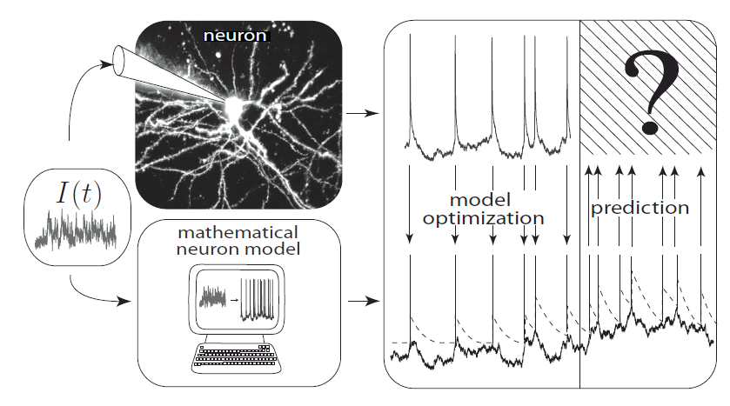
Neuronal Dynamics – 9.1 Neuron Models and Data
What is a good neuron model?
Estimate parameters of models?

Slide 3
Neuronal Dynamics – 9.1 What is a good neuron model?
Predict spike times
Predict subthreshold voltage
Easy to interpret (not a ‘black box’)
Flexible enough to account for a variety of phenomena
Systematic procedure to ‘optimize’ parameters

Slide 4
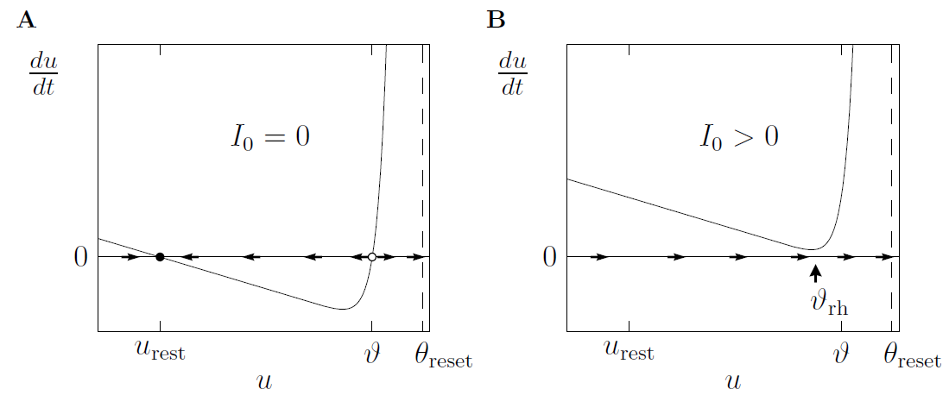
Neuronal Dynamics – Review: Nonlinear Integrate-and-fire
See:
week 1,
lecture 1.5
What is a good choice of f ?

Slide 5
Neuronal Dynamics – Review: Nonlinear Integrate-and-fire
(1)
(2)
What is a good choice of f ?
(i) Extract f from more complex models
(ii) Extract f from data

Slide 6
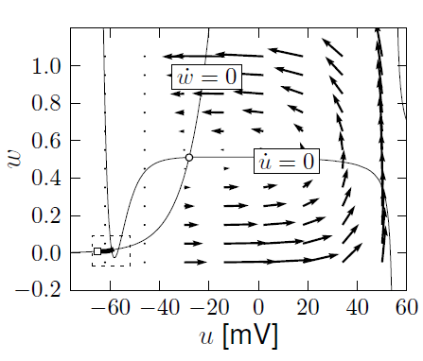
Neuronal Dynamics – Review: Nonlinear Integrate-and-fire
(i) Extract f from more complex models
A. detect spike and reset
resting state
Separation of time scales:
Arrows are nearly horizontal
Spike initiation, from rest
See week 3:
2dim version of
Hodgkin-Huxley
B. Assume w=wrest

Slide 7
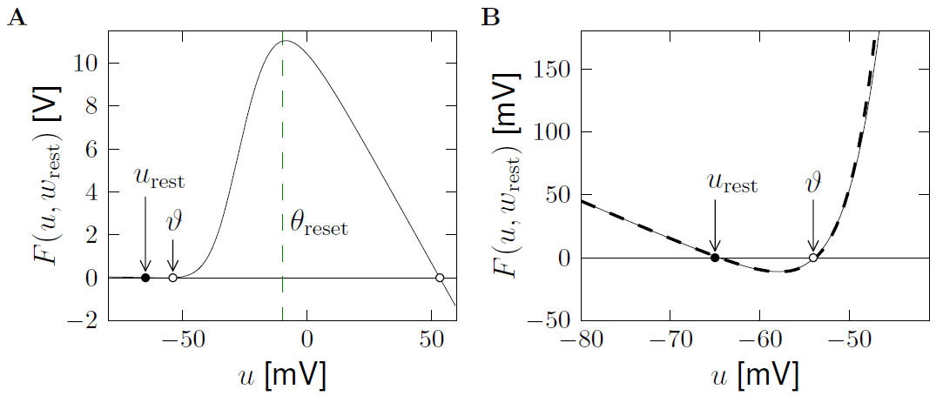
Neuronal Dynamics – Review: Nonlinear Integrate-and-fire
(i) Extract f from more complex models
exponential
linear
See week 4:
2dim version of
Hodgkin-Huxley
Separation of
time scales

Slide 8
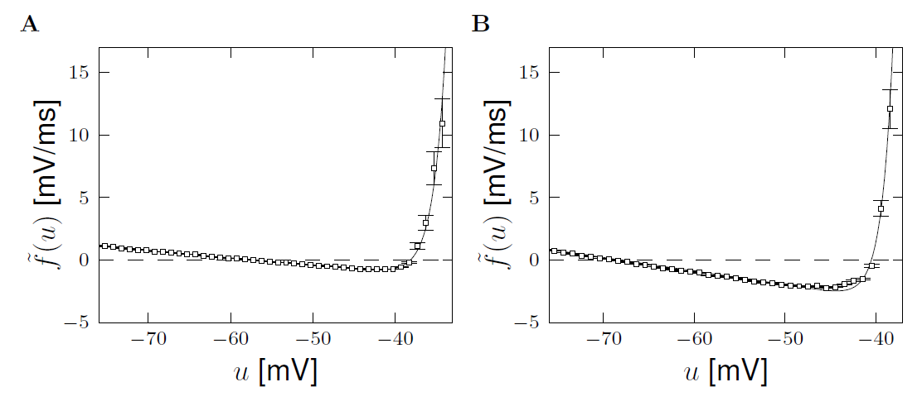
Neuronal Dynamics – Review: Nonlinear Integrate-and-fire
(ii) Extract f from data
Badel et al. (2008)
Exp. Integrate-and-Fire, Fourcaud et al. 2003
Pyramidal neuron
Inhibitory interneuron
exponential
exponential
Badel et al. (2008)
linear
linear

Slide 9
Neuronal Dynamics – Review: Nonlinear Integrate-and-fire
(1)
(2)
Best choice of f : linear + exponential
BUT: Limitations – need to add
Adaptation on slower time scales
Possibility for a diversity of firing patterns
Increased threshold after each spike
Noise

Slide 10
Biological Modeling of Neural Networks:
Week 9 – part 2 : Adaptive Expontential Integrate-and-Fire Model
9.1 What is a good neuron model?
- Models and data
9.2 AdEx model
- Firing patterns and adaptation
9.3 Spike Response Model (SRM)
- Integral formulation
9.4 Generalized Linear Model
- Adding noise to the SRM
9.5 Parameter Estimation
- Quadratic and convex optimization
9.6. Modeling in vitro data
- how long lasts the effect of a spike?
Week 9 – Optimizing Neuron Models
For Coding and Decoding
Wulfram Gerstner
EPFL, Lausanne, Switzerland

Slide 11
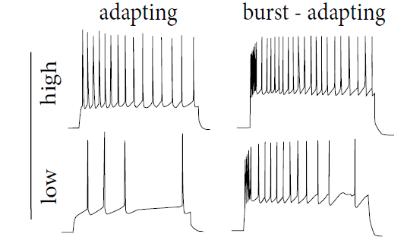
Neuronal Dynamics – 9.2 Adaptation
Step current input – neurons show adaptation
I(t)
Data:
Markram et al.
(2004)
1-dimensional (nonlinear) integrate-and-fire model cannot do this!

Slide 12
Neuronal Dynamics – 9.2 Adaptive Exponential I&F
Add adaptation variables:
Blackboard !
Exponential I&F
+ 1 adaptation var.
= AdEx
SPIKE AND RESET
after each spike
AdEx model,
Brette&Gerstner (2005):
jumps by an amount

Slide 13
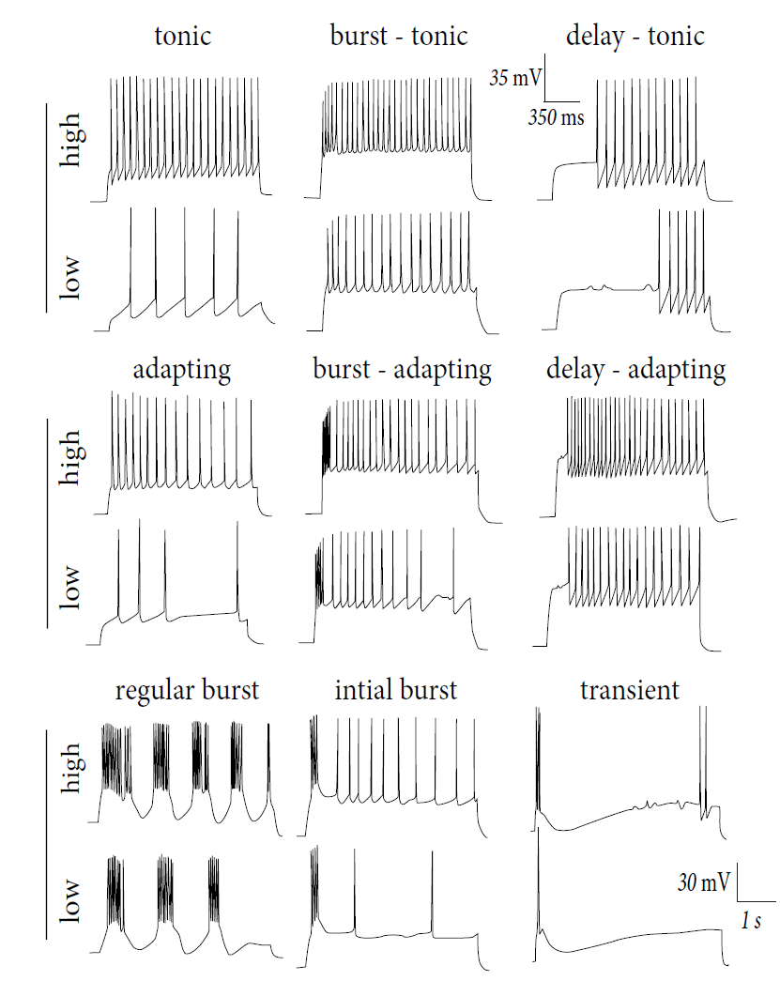
Firing patterns:
Response to
Step currents,
Exper. Data,
Markram et al.
(2004)
I(t)

Slide 14
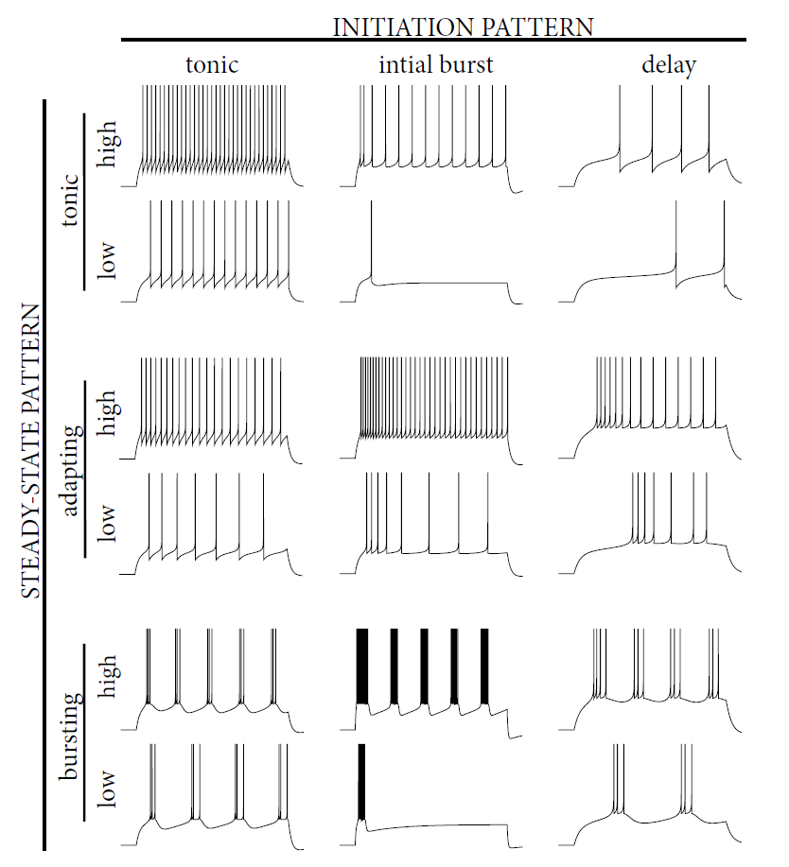
Firing patterns:
Response to
Step currents,
AdEx Model,
Naud&Gerstner
I(t)
Image:
Neuronal Dynamics,
Gerstner et al.
Cambridge (2002)

Slide 15
Neuronal Dynamics – 9.2 Adaptive Exponential I&F
AdEx model
Phase plane analysis!
Can we understand the different firing patterns?

Slide 16
Neuronal Dynamics – Quiz 9.1. Nullclines of AdEx
A - What is the qualitative
shape of the w-nullcline?
[ ] constant
[ ] linear, slope a
[ ] linear, slope 1
[ ] linear + quadratic
[ ] linear + exponential
B - What is the qualitative
shape of the u-nullcline?
[ ] linear, slope 1
[ ] linear, slope 1/R
[ ] linear + quadratic
[ ] linear w. slope 1/R+ exponential
1 minute
Restart at 9:38

Slide 17
Biological Modeling of Neural Networks:
Week 9 – part 2b : Firing Patterns
9.1 What is a good neuron model?
- Models and data
9.2 AdEx model
- Firing patterns and adaptation
9.3 Spike Response Model (SRM)
- Integral formulation
9.4 Generalized Linear Model
- Adding noise to the SRM
9.5 Parameter Estimation
- Quadratic and convex optimization
9.6. Modeling in vitro data
- how long lasts the effect of a spike?
Week 9 – Optimizing Neuron Models
For Coding and Decoding
Wulfram Gerstner
EPFL, Lausanne, Switzerland

Slide 18
after each spike
AdEx model
u is reset to ur
after each spike
w jumps by an amount b
parameter a – slope of w-nullcline
Can we understand the different firing patterns?

Slide 19
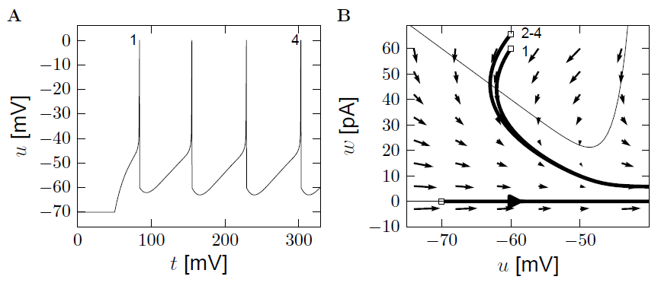
AdEx model – phase plane analysis: large b
a=0
u-nullcline
b
u is reset to ur

Slide 20
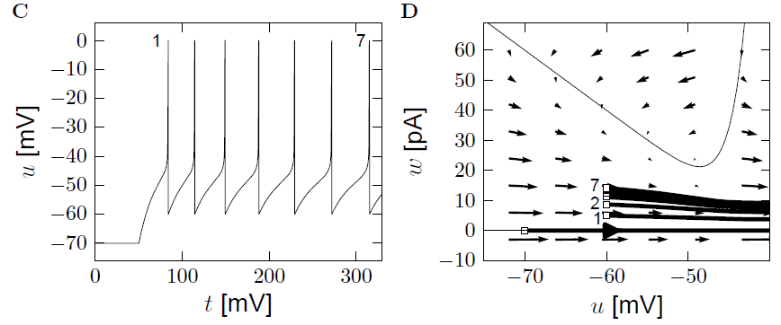
AdEx model – phase plane analysis: small b
adaptation
u-nullcline
b
u is reset to ur

Slide 21
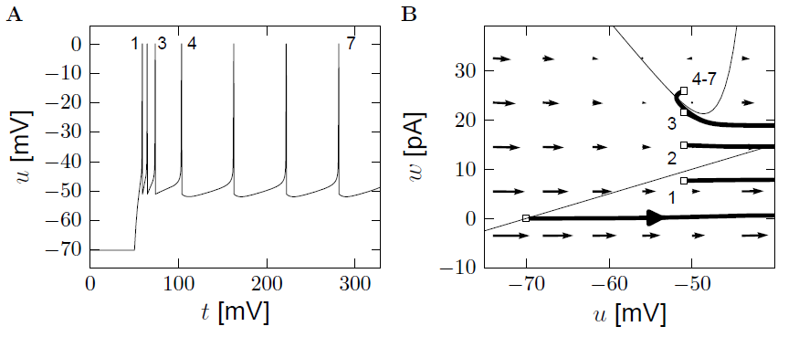
Quiz 9.2: AdEx model – phase plane analysis
What firing pattern do you expect?
(i) Adapting
(ii) Bursting
(iii) Initial burst
(iv)Non-adapting
u-nullcline
b
u is reset to ur

Slide 22
AdEx model – phase plane analysis: a>0
u-nullcline
b
u is reset to ur

Slide 23
Neuronal Dynamics – 9.2 AdEx model and firing patterns
after each spike
u is reset to ur
after each spike
w jumps by an amount b
parameter a – slope of w nullcline
Firing patterns arise from different parameters!
See Naud et al. (2008), see also Izikhevich (2003)

Slide 24
Neuronal Dynamics – Review: Nonlinear Integrate-and-fire
(1)
(2)
Best choice of f : linear + exponential
BUT: Limitations – need to add
Adaptation on slower time scales
Possibility for a diversity of firing patterns
Increased threshold after each spike
Noise

Slide 25
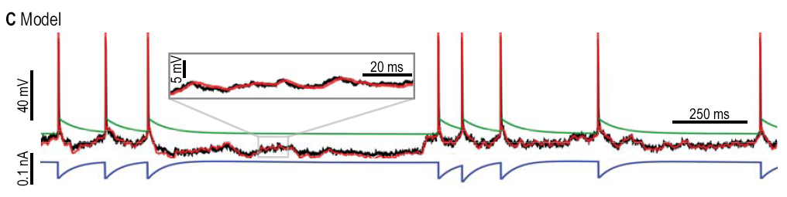
Neuronal Dynamics – 9.2 AdEx with dynamic threshold
Add dynamic threshold:
Threshold increases after each spike

Slide 26
Neuronal Dynamics – 9.2 Generalized Integrate-and-fire
add
Adaptation variables
Possibility for firing patterns
Dynamic threshold
Noise

Slide 27
Biological Modeling of Neural Networks:
Week 9 – part 3: Spike Response Model (SRM)
9.1 What is a good neuron model?
- Models and data
9.2 AdEx model
- Firing patterns and adaptation
9.3 Spike Response Model (SRM)
- Integral formulation
9.4 Generalized Linear Model
- Adding noise to the SRM
9.5 Parameter Estimation
- Quadratic and convex optimization
9.6. Modeling in vitro data
- how long lasts the effect of a spike?
Week 9 – Optimizing Neuron Models
For Coding and Decoding
Wulfram Gerstner
EPFL, Lausanne, Switzerland

Slide 28
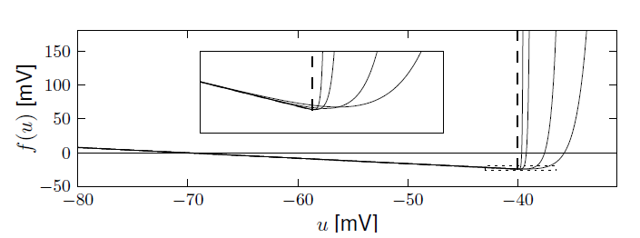
Exponential versus Leaky Integrate-and-Fire
Badel et al (2008)
Leaky Integrate-and-Fire
Reset if u=

Slide 29
Neuronal Dynamics – 9.3 Adaptive leaky integrate-and-fire
after each spike
SPIKE AND RESET
jumps by an amount
Dynamic threshold

Slide 30
Neuronal Dynamics – 9.3 Adaptive leaky I&F and SRM
Adaptive
leaky I&F
Linear equation → can be integrated!
Spike Response Model (SRM)
Gerstner et al. (1996)

Slide 31
Neuronal Dynamics – 9.3 Spike Response Model (SRM)
Gerstner et al.,
1993, 1996
i
Input
I(t)
Spike emission
u(t)
Arbitrary
Linear filters
potential
threshold

Slide 32
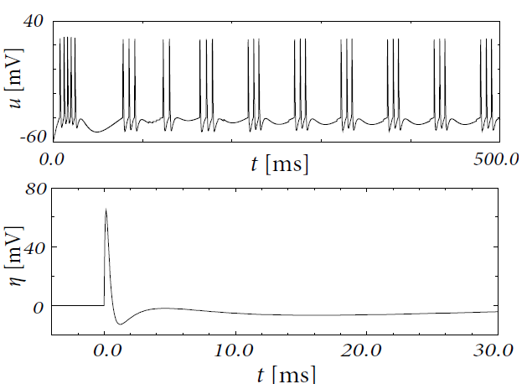
Neuronal Dynamics – 9.3 Bursting in the SRM
SRM with appropriate
leads to bursting

Slide 33
Exercise 1: from adaptive IF to SRM
Next lecture
at 9:57/10:15
Integrate the above system of two differential equations so as to rewrite the equations as
potential
A – what is ?
(i)
(ii)
B – what is ?
(iii)
(iv) Combi of
(i) + (iii)
Notes:
Exercise should start before the break.

Slide 34
Neuronal Dynamics – 9.3 Spike Response Model (SRM)
Gerstner et al.,
1993, 1996
Input
I(t)
S(t)
+
potential
threshold
firing if

Slide 35
Neuronal Dynamics – 9.3 Spike Response Model (SRM)
potential
+
threshold
Linear filters for
- input
- threshold
- refractoriness

Slide 36
Biological Modeling of Neural Networks:
Week 9 – part 4: Generalized Linear Model (GLM)
9.1 What is a good neuron model?
- Models and data
9.2 AdEx model
- Firing patterns and adaptation
9.3 Spike Response Model (SRM)
- Integral formulation
9.4 Generalized Linear Model
- Adding noise to the SRM
9.5 Parameter Estimation
- Quadratic and convex optimization
9.6. Modeling in vitro data
- how long lasts the effect of a spike?
Week 9 – Optimizing Neuron Models
For Coding and Decoding
Wulfram Gerstner
EPFL, Lausanne, Switzerland

Slide 37

Spike Response Model (SRM)
Generalized Linear Model GLM
Gerstner et al.,
1992,2000
Truccolo et al., 2005
Pillow et al. 2008
I(t)
S(t)
+
potential
threshold
firing intensity

Slide 38
Neuronal Dynamics – review from week 8: Escape noise
escape process
escape rate
u(t)
t
escape rate
Example: leaky integrate-and-fire model
u

Slide 39
Exerc. 2.1: Non-leaky IF with escape rates
nonleaky
Integrate for constant input (repetitive firing)
Next lecture
at 10:38
Calculate
- potential
- hazard
- survivor function
- interval distrib.
Notes:
12 minutes for the students, to do the exercise

Slide 40
Neuronal Dynamics – review from week 8: Escape noise
escape process
Survivor function
u(t)
t
escape rate
Interval distribution
escape
rate
Good choice
Survivor function
u

Slide 41
Neuronal Dynamics – 9.4 Likelihood of a spike train in GLMs
Blackboard
Measured spike train with spike times
Likelihood L that this spike train
could have been generated by model?

Slide 42
Neuronal Dynamics – 9.4 Likelihood of a spike train

Slide 43
Neuronal Dynamics – 9.4 SRM with escape noise = GLM
+
linear filters
escape rate
→likelihood of observed
spike train
parameter optimization
of neuron model

Slide 44
Biological Modeling of Neural Networks:
Week 9 – part 5: Parameter Estimation
9.1 What is a good neuron model?
- Models and data
9.2 AdEx model
- Firing patterns and adaptation
9.3 Spike Response Model (SRM)
- Integral formulation
9.4 Generalized Linear Model
- Adding noise to the SRM
9.5 Parameter Estimation
- Quadratic and convex optimization
9.6. Modeling in vitro data
- how long lasts the effect of a spike?
Week 9 – Optimizing Neuron Models
For Coding and Decoding
Wulfram Gerstner
EPFL, Lausanne, Switzerland

Slide 45
Neuronal Dynamics – 9.5 Parameter estimation: voltage
Spike Response Model (SRM)
Generalized Lin. Model (GLM)
S(t)
I(t)
+
Subthreshold
potential
known spike train
known input
Linear filters/linear in parameters

Slide 46
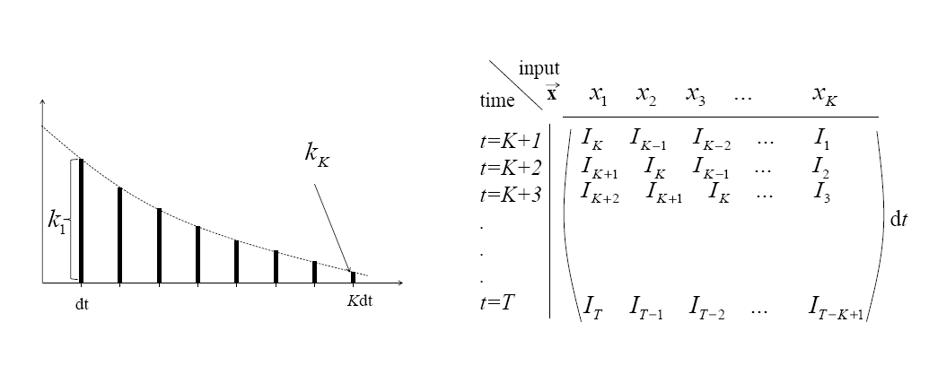
Neuronal Dynamics – 9.5 Parameter estimation: voltage
Linear in parameters = linear fit = quadratic problem
comparison model-data
Blackboard: Riemann-sum

Slide 47
Neuronal Dynamics – 9.5 Parameter estimation: voltage
Linear in parameters = linear fit
I
Blackboard: Error function

Slide 48
Neuronal Dynamics – 9.5 Parameter estimation: voltage
Linear in parameters = linear fit = quadratic optimization
Model
Data
I

Slide 49
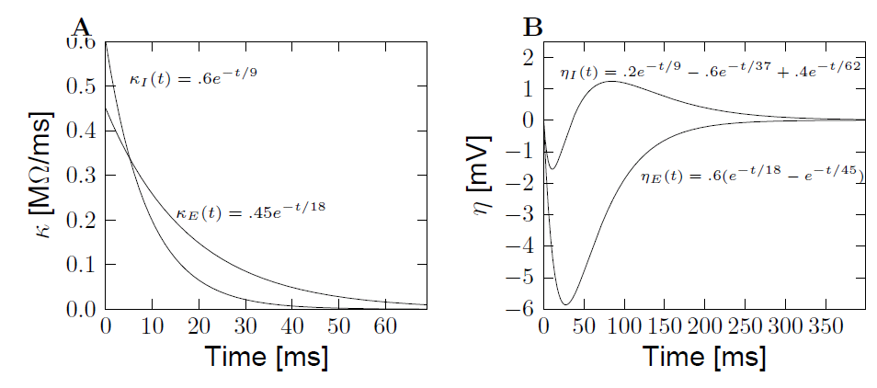
Neuronal Dynamics – 9.5 Extracted parameters: voltage
Subthreshold
potential
known input
known spike train
inhibitory
interneuron
pyramidal
pyramidal
Mensi et al., 2012

Slide 50
Exercise 3 NOW: optimize 1 free parameter
Model
Data
Optimize parameter R, so as to have a minimal error
I

Slide 51
Neuronal Dynamics – What is a good neuron model?
Predict spike times
Predict subthreshold voltage
Easy to interpret (not a ‘black box’)
Flexible
Systematic: ‘optimize’ parameters

Slide 52
Biological Modeling of Neural Networks:
Week 9 – part 5b: Quadratic and Convex Optimization
9.1 What is a good neuron model?
- Models and data
9.2 AdEx model
- Firing patterns and adaptation
9.3 Spike Response Model (SRM)
- Integral formulation
9.4 Generalized Linear Model
- Adding noise to the SRM
9.5 Parameter Estimation
- Quadratic and convex optimization
9.6. Modeling in vitro data
- how long lasts the effect of a spike?
Week 9 – Optimizing Neuron Models
For Coding and Decoding
Wulfram Gerstner
EPFL, Lausanne, Switzerland

Slide 53
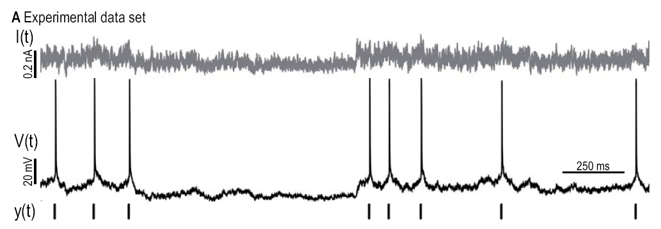
Fitting models to data: so far ‘subthreshold’
Dyn. threshold
Adaptation current

Slide 54
Neuronal Dynamics – 9.5 Threshold: Predicting spike times
Jolivet&Gerstner, 2005
Paninski et al., 2004
Pillow et al. 2008
I(t)
S(t)
+
potential
threshold
firing intensity

Slide 55
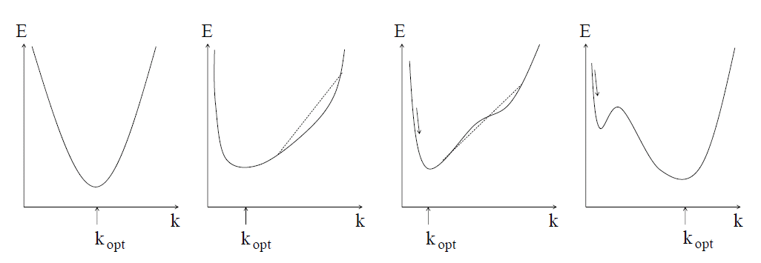
Neuronal Dynamics – 9.5 Generalized Linear Model (GLM)
potential
threshold
firing intensity

Slide 56
Neuronal Dynamics – 9.5 GLM: concave error function
potential
threshold
firing intensity
Paninski, 2004

Slide 57
Neuronal Dynamics – 9.5 quadratic and convex/concave optimization
Voltage/subthreshold
- linear in parameters
→ quadratic error function
Spike times
- nonlinear, but GLM
→ convex error function

Slide 58
Quiz NOW :
What are the units of ?
Voltage?
Resistance?
Resistance/s?
Current?
I(t)
S(t)
+
potential
threshold
firing intensity

Slide 59
Quiz NOW:
What are the units of ?
Voltage?
Resistance?
Resistance/s?
Current?
I(t)
S(t)
+
potential
threshold
firing intensity

Slide 60
Biological Modeling of Neural Networks:
Week 9 – part 6: Modeling in vitro data
9.1 What is a good neuron model?
- Models and data
9.2 AdEx model
- Firing patterns and adaptation
9.3 Spike Response Model (SRM)
- Integral formulation
9.4 Generalized Linear Model
- Adding noise to the SRM
9.5 Parameter Estimation
- Quadratic and convex optimization
9.6. Modeling in vitro data
- how long lasts the effect of a spike?
9.7. Helping Humans
Week 9 – Optimizing Neuron Models
For Coding and Decoding
Wulfram Gerstner
EPFL, Lausanne, Switzerland

Slide 61
Neuronal Dynamics – 9.6 Models and Data
comparison model-data
Predict
Subthreshold voltage
Spike times

Slide 62
Neuronal Dynamics – 9.6 GLM/SRM with escape noise
Jolivet&Gerstner, 2005
Paninski et al., 2004
Pillow et al. 2008
I(t)
S(t)
+
potential
threshold
firing intensity

Slide 63
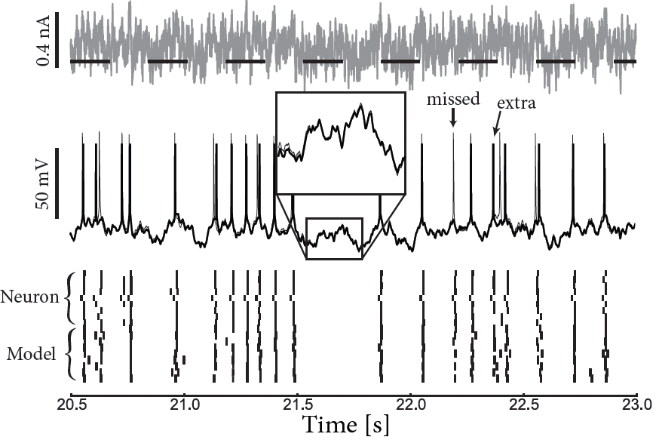
Neuronal Dynamics – 9.6 GLM/SRM predict subthreshold voltage
neuron
Image:Mensi et al.
model

Slide 64
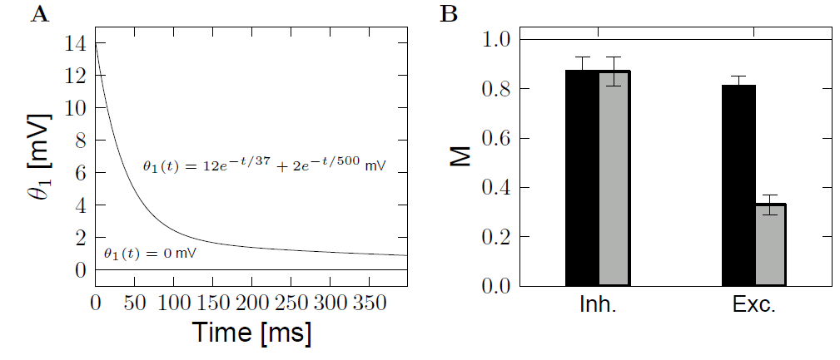
Neuronal Dynamics – 9.6 GLM/SRM predict spike times
Role of moving threshold
No moving threshold
With moving threshold
Mensi et al., 2012

Slide 65
Change in model formulation:
‘soft-threshold
adaptive IF model’
What are the units of …. ?
exponential
I(t)
S(t)
+
adaptation
current
potential
threshold
firing intensity

Slide 66
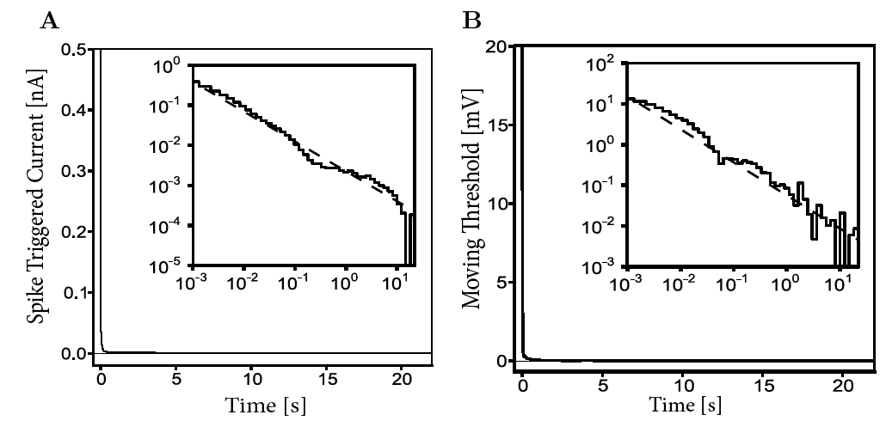
Neuronal Dynamics – 9.6 How long does the effect of a spike last?
Time scale of filters?
→ Power law
A single spike has a measurable effect
more than 10 seconds later!
Pozzorini et al. 2013

Slide 67
Neuronal Dynamics – 9.6 Models and Data
-Predict spike times
-Predict subthreshold voltage
-Easy to interpret (not a ‘black box’)
-Variety of phenomena
-Systematic: ‘optimize’ parameters
BUT so far limited to in vitro

Slide 68
Neuronal Dynamics week 7– Suggested Reading/selected references
Reading: W. Gerstner, W.M. Kistler, R. Naud and L. Paninski,
Neuronal Dynamics: from single neurons to networks and models of cognition. Ch. 6,10,11: Cambridge, 2014
Nonlinear and adaptive IF
Fourcaud-Trocme, N., Hansel, D., van Vreeswijk, C., and Brunel, N. (2003). How spike …. J. Neuroscience, 23:11628-11640.
Badel, L., et al. (2008a). Extracting nonlinear integrate-and-fire, Biol. Cybernetics, 99:361-370.
Brette, R. and Gerstner, W. (2005). Adaptive exponential integrate-and-fire J. Neurophysiol., 94:3637- 3642.
Izhikevich, E. M. (2003). Simple model of spiking neurons. IEEE Trans Neural Netw, 14:1569-1572.
Gerstner, W. (2008). Spike-response model. Scholarpedia, 3(12):1343.
Optimization methods for neuron models, max likelihood, and GLM
-Brillinger, D. R. (1988). Maximum likelihood analysis of spike trains of interacting nerve cells. Biol. Cybern., 59:189-200.
-Truccolo, et al. (2005). A point process framework for relating neural spiking activity to spiking history, neural ensemble, and extrinsic covariate effects. Journal of Neurophysiology, 93:1074-1089.
- Paninski, L. (2004). Maximum likelihood estimation of … Network: Computation in Neural Systems, 15:243-262.
- Paninski, L., Pillow, J., and Lewi, J. (2007). Statistical models for neural encoding, decoding, and optimal
stimulus design. In Cisek, P., et al. , Comput. Neuroscience: Theoretical Insights into Brain Function. Elsevier Science.
Pillow, J., ET AL.(2008). Spatio-temporal correlations and visual signalling… . Nature, 454:995-999.
Rieke, F., Warland, D., de Ruyter van Steveninck, R., and Bialek, W. (1997). Spikes - Exploring the neural code. MIT Press,
Keat, J., Reinagel, P., Reid, R., and Meister, M. (2001). Predicting every spike … Neuron, 30:803-817.
Mensi, S., et al. (2012). Parameter extraction and classication …. J. Neurophys.,107:1756-1775.
Pozzorini, C., Naud, R., Mensi, S., and Gerstner, W. (2013). Temporal whitening by . Nat. Neuroscience,
Georgopoulos, A. P., Schwartz, A.,Kettner, R. E. (1986). Neuronal population coding of movement direction. Science, 233:1416-1419.
Donoghue, J. (2002). Connecting cortex to machines: recent advances in brain interfaces. Nat. Neurosci., 5:1085-1088.
Encoding and Decoding

Slide 69
The END

Slide 70
Neuronal Dynamics – Quiz 9.2. Nullclines for constant input
Only during reset
a=0
u-nullcline
What happens if input switches from I=0 to I>0?
[ ] u-nullcline moves horizontally
[ ] u-nullcline moves vertically
[ ] w-nullcine moves horizontally
[ ] w-nullcline moves vertically
u-nullcline
u

Slide 71
Neuronal Dynamics – 9.5 Parameter estimation: voltage
Vector notation

Slide 72
Neuronal Dynamics – 9.5 Parameter estimation: voltage
Linear in parameters = linear fit = quadratic problem

Slide 73
Biological Modeling of Neural Networks:
Week 9 – part 7: Helping Humans
9.1 What is a good neuron model?
- Models and data
9.2 AdEx model
- Firing patterns and adaptation
9.3 Spike Response Model (SRM)
- Integral formulation
9.4 Generalized Linear Model
- Adding noise to the SRM
9.5 Parameter Estimation
- Quadratic and convex optimization
9.6. Modeling in vitro data
- how long lasts the effect of a spike?
9.7. Helping Humans
Week 9 – Optimizing Neuron Models
For Coding and Decoding
Wulfram Gerstner
EPFL, Lausanne, Switzerland

Slide 74
Neuronal Dynamics – Review: Models and Data
-Predict spike times
-Predict subthreshold voltage
-Easy to interpret (not a ‘black box’)
-Variety of phenomena
-Systematic: ‘optimize’ parameters
BUT so far limited to in vitro

Slide 75
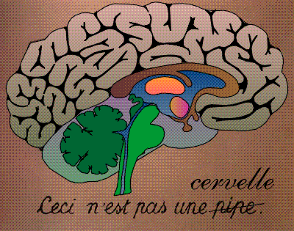
Neuronal Dynamics – 7.7 Systems neuroscience, in vivo
Now: extracellular
recordings
visual
cortex
Predict spike times, given stimulus
Predict subthreshold voltage
Easy to interpret (not a ‘black box’)
Flexible enough to account for a variety of phenomena
Systematic procedure to ‘optimize’ parameters
Model of ‘Encoding’

Slide 76
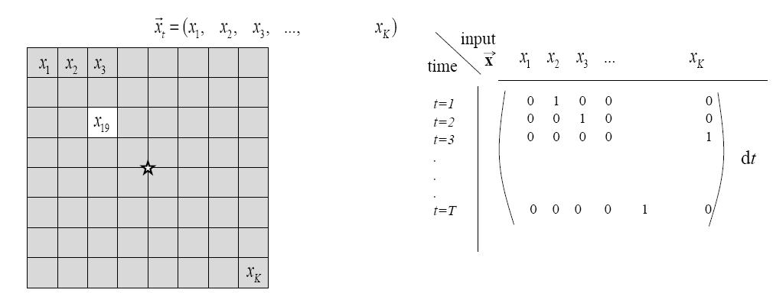
Neuronal Dynamics – 7.7 Estimation of receptive fields
Estimation of spatial (and temporal) receptive fields
LNP
firing intensity

Slide 77
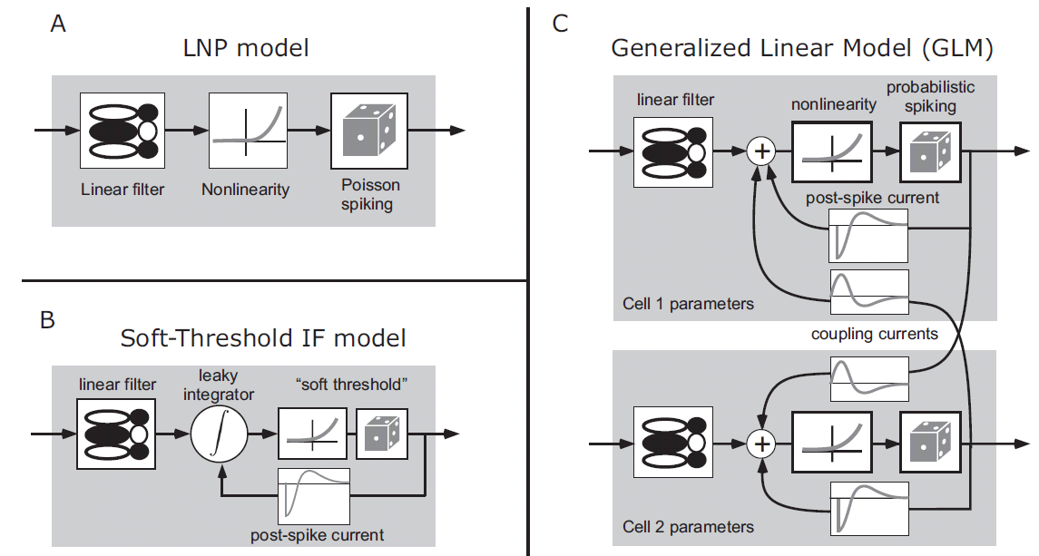
Neuronal Dynamics – 7.7 Estimation of Receptive Fields
visual
stimulus
LNP =
Linear-Nonlinear-Poisson
Special case of
GLM=
Generalized Linear Model

Slide 78
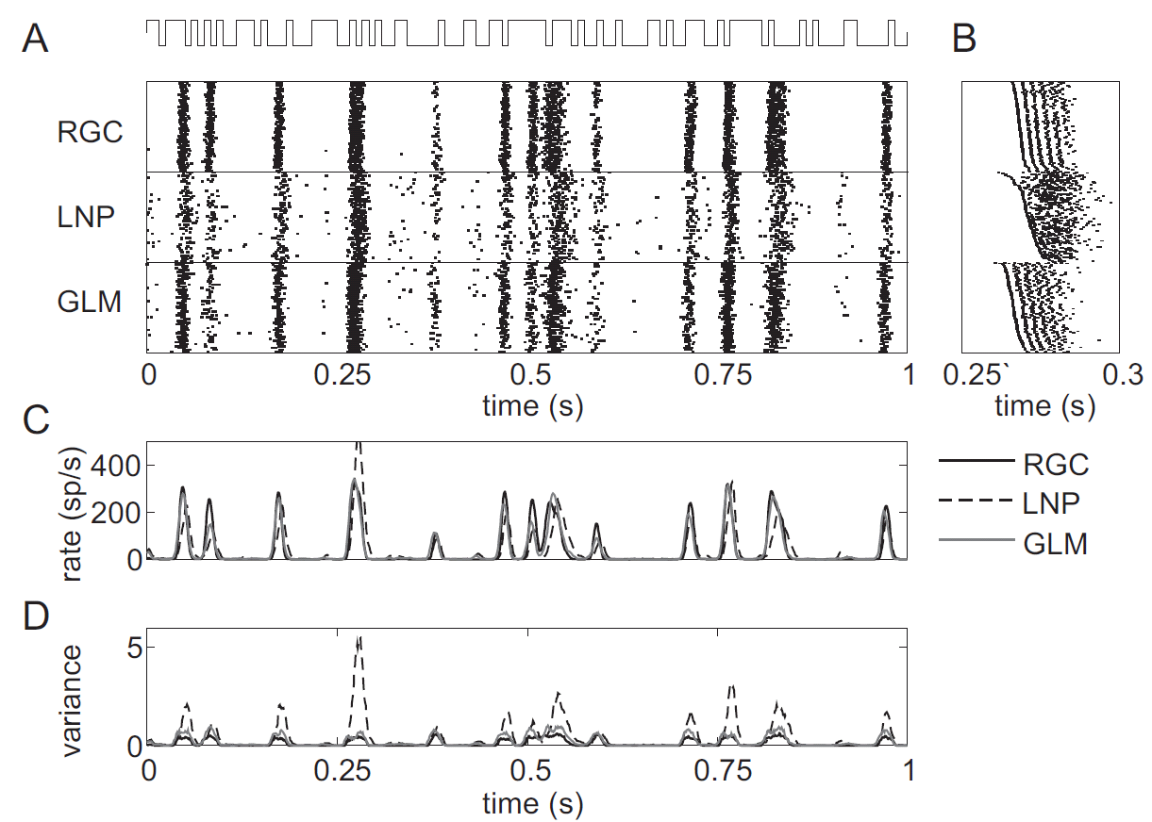
GLM for prediction of retinal ganglion ON cell activity
Pillow et al. 2008

Slide 79
Neuronal Dynamics – 7.7 GLM with lateral coupling

Slide 80
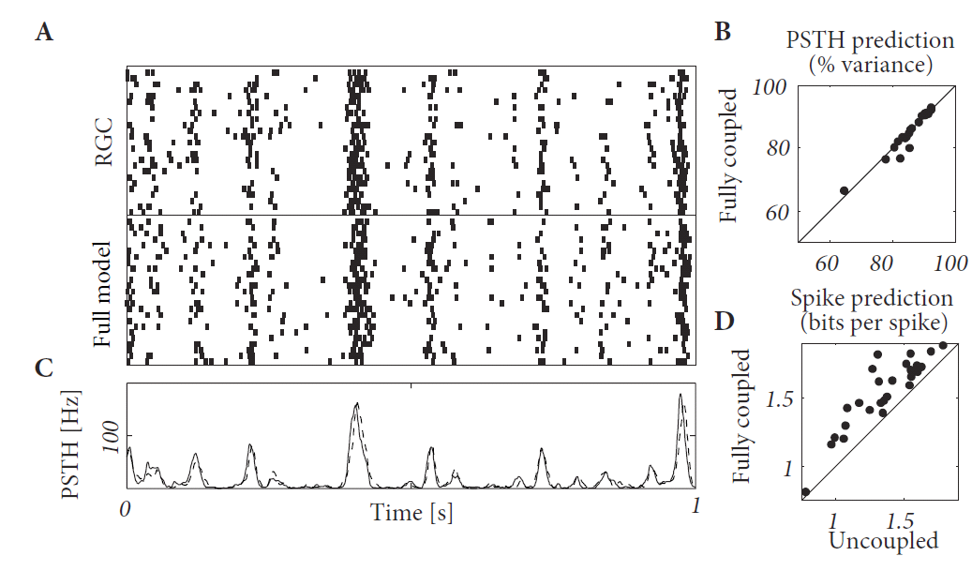
One cell in a Network of Ganglion cells
Pillow et al. 2008

Slide 81
Neuronal Dynamics – 7.7 Model of ENCODING
visual
cortex
Predict spike times, given stimulus
Predict subthreshold voltage
Easy to interpret (not a ‘black box’)
Flexible enough to account for a variety of phenomena
Systematic procedure to ‘optimize’ parameters
Model of ‘Encoding’

Slide 82
Neuronal Dynamics – 7.7 ENCODING and Decoding
Model of ‘Encoding’
Generalized Linear Model (GLM)
- flexible model
- systematic optimization
of parameters
Model of ‘Decoding’
The same GLM works!
- flexible model
- systematic optimization
of parameters

Slide 83
Neuronal Dynamics – 7.7 Model of DECODING
Predict stimulus!
visual
cortex
Model of ‘Decoding’:
predict stimulus, given spike times

Slide 84
Neuronal Dynamics – 7.7 Helping Humans
Application: Neuroprosthetics
frontal
cortex
Many groups
world wide
work on this
problem!
motor
cortex
Model of
‘Decoding’
Predict intended arm movement,
given Spike Times

Slide 85
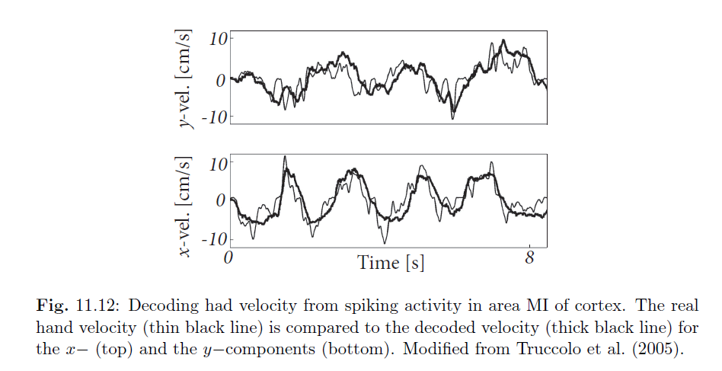
Neuronal Dynamics – 7.7 Basic neuroprosthetics
Application: Neuroprosthetics
Decode the intended arm movement
Hand velocity

Slide 86
Neuronal Dynamics – 7.7 Why mathematical models?
Mathematical models
for neuroscience
help humans
The end

